Slide 1
Fiscal Year 2026
Active Reserve SNCO
Promotion Selection Board
Col James E. Graham
Board President
Major William C. Griffin
Enlisted Promotion Head
MMPB, M&RA

Slide 2
Board Overview
Purpose: Consider the best and fully qualified Marines for promotion to meet the needs of the Marine Corps.
Board Membership (13)
  (1) Colonel
  (1) Lieutenant Colonels
  (2) Majors
  (1) Chief Warrant Officer 3
  (3) Sergeants Major
  (5) Master Gunnery Sergeants
  Board Recorders: (3)
Total Above Zone (AZ) / In Zone (IZ) / Below Zone (BZ)
  President screened the BZ for premier/non-premier
    (1) BZ Premier Briefs
  Average of approximately 17 total cases per member

Slide 3
Board Overview
Selection Board convened 4 February 2026
  Monday – Saturday
  0730 – 1730, with 3-5 minute breaks approx. every hour
  Board Days Breakdown (6 days)
    Admin Days: .5 / 8%
    Days only preparing: 1 / 17%
    Days only briefing: 1 / 17%
    Days combined preparing/briefing: 3.5 / 58%
    Prep time was approximately 30 minutes per case
    Briefing time allocation: 3:00
Items that Increased Tempo
  Abbreviated SSgt Script
  Further condensed brief for PME incomplete / request non-selection
  Clear guidance from Board President throughout
  Board Recorders daily management and completion projection.
  *Note: Board began 1 day late due to weather impacting Camp Lejeune area. The Board also dropped 2x board members (1x Maj & 1x SgtMaj) due to those same weather impacts.

Slide 4
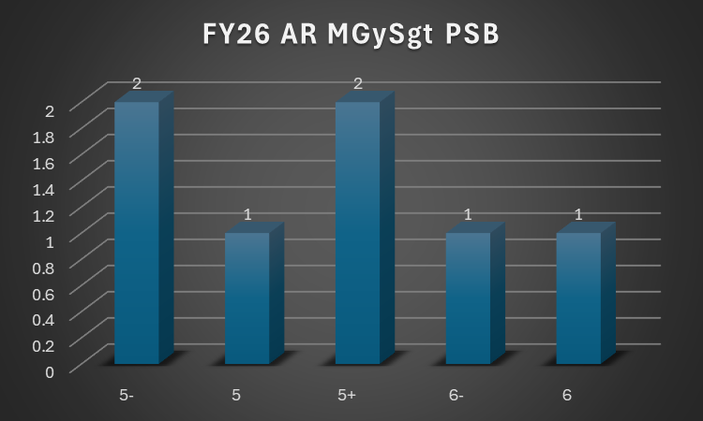
FY26 AR MGySgt PSB Overview
Statistics
Key Takeaways
More MOS’s in FY26 but lower density in populations
Zero Shortfalls
Highly rated packages

Slide 5
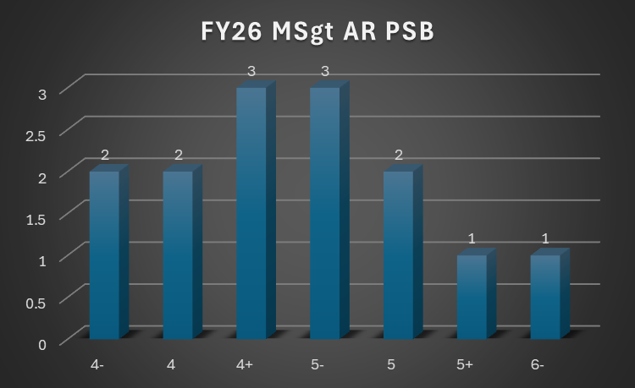
FY26 AR MSgt PSB Overview
Statistics
Key Takeaways
Similar stats for the last two years
Zero shortfalls

Slide 6
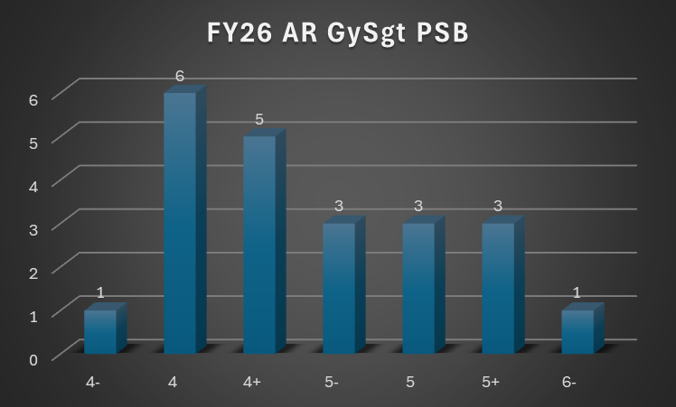
FY26 AR GySgt PSB Overview
Statistics
Key Takeaways
Larger population and higher selection rates.
Zero Shortfalls
1x Noncompetitive (WO)

Slide 7
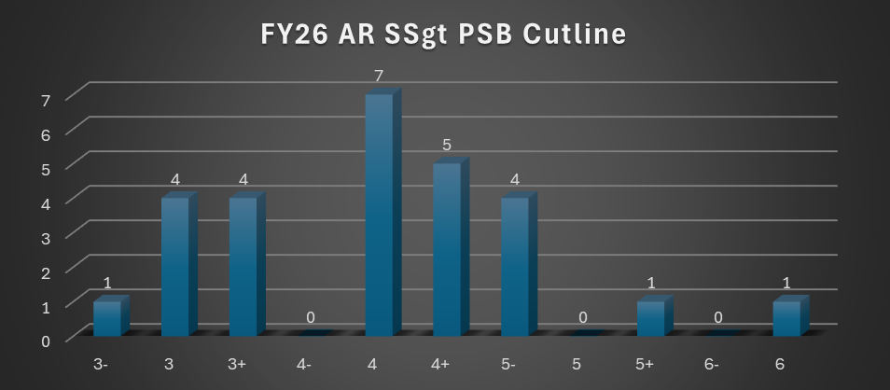
FY26 AR SSgt PSB Overview
Statistics
Key Takeaways
Larger population and higher selection rates.
Zero Shortfalls
Low PME Incompletes

Slide 8
FY26 President Comments
Performance trumped everything else
For Active Reserve Boards, continue to ensure the at least one enlisted and one officer board member are Active Reserve
Letters to the Board were sparse. Many candidates who didn’t submit letters would have benefited from doing so
Sergeants have got to do their non-resident PME before the board
Biggest reason for a 2 rating was chronic adversity or adversity in grade
‘Hidden’ adversity disrupted briefing
DBR is a force multiplier – continue to invest and enhance it
The Enlisted Promotion Branch Staff was outstanding !!

Slide 9
Questions?

